Slide 1

Embedding PHP in HTML
Week 7

Slide 2
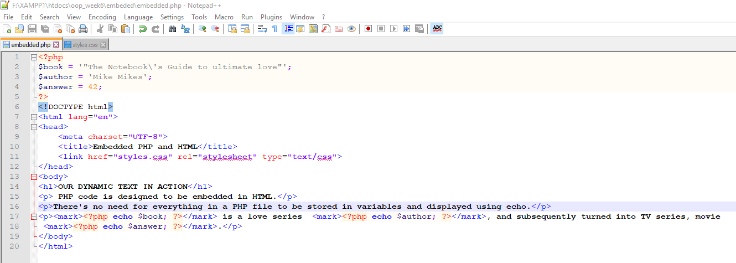
Embedded text

Slide 3
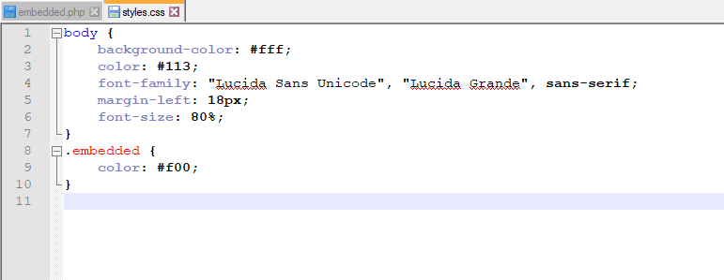

Slide 4
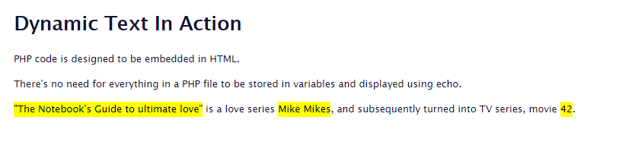
Output will be like this

Slide 5
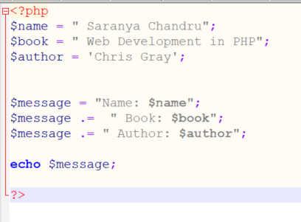
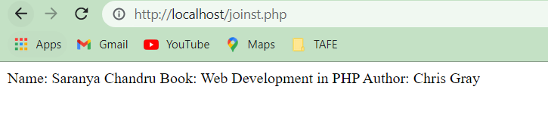
Join strings

Slide 6
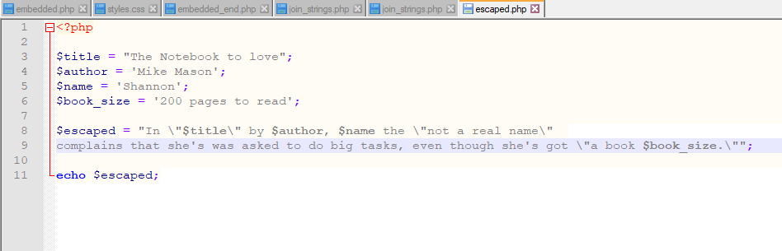
Next example
OUTPUT

Slide 7
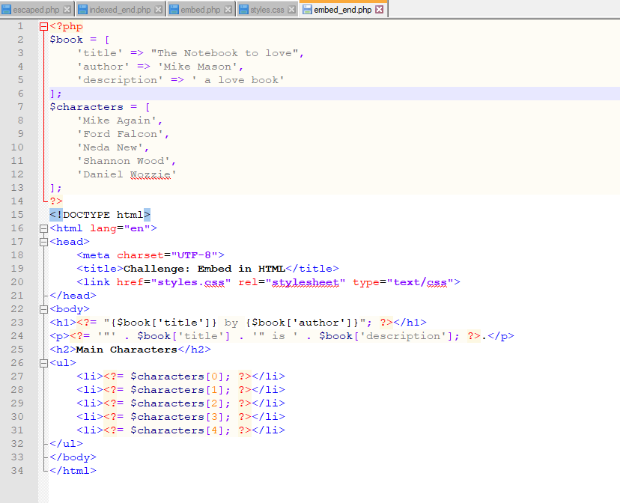

Lets add more
<?= same as <?php echo

